Slide 1
Intro to Data Analysis & machine learning
Capt Guillermo Aguirre
11 feb 2021

Slide 2
ICE BREAKER
Is it pronounced, dayta or d@ta ???

Slide 3
Overview
The Intent of this Tradecraft Session
What not to expect from this Tradecraft Session
Rules of Engagement
Why Machine Learning?
Why not Machine Learning?
The ML model we will explore
To the notebooks!

Slide 4
The Intent of this Tradecraft Session
Exposure to the
ML process
Data analysis techniques & their interpretations
ML concepts and limitations
To have a high-level understanding of what ML is and is not.
To arm you with knowledge of the ML process from a practitioner's perspective

Slide 5


What not to expect from this Tradecraft Session
As a result of this session, you will not be a machine learning engineer or data scientist
What I think my skill-level is… | What my skill-level actually is…

Slide 6


Rules of engagement
This is the way. Some concepts or actions are best practices or are from my experience. So, some questions I’ll refer you to external resources and I don’t want to belabor theory explaining. However, I encourage questions along the way!
I may ask questions from people in the audience.
Feel free to tinker and experiment with the notebooks as we go along! In fact, there are at least two parts where we do just that ☺

Slide 7
Why machine learning?
I started my career in a defensive cyber operations (DCO) mindset and then expanded to enterprise DOD information networks operations (DODIN Ops). Both of these environments require interacting and interpreting massive datasets.
To handle such information, one must have the means of organizing and developing insight from the data at hand.

Slide 8
Why machine learning?
DCO | DODIN
Identify
Protect
Detect
Respond
Recover
Build
Operate
Secure
Sustain

Slide 9
Why not machine learning?
Can use in your personal life, such as predictive next years electric bills using data of weather, electric usage, vacations taken, etc
Can leverage in your professional life, such as discovering trends in meeting durations, budget, ADLS training completions, OPR/EPR completions, etc.
There are emerging python platforms that are becoming mainstream where you don’t have to understand matrix calculus, probability theory, and linear algebra. And I’ll provide links to an amazing resource(s) where you can explore your domain with ML frameworks!
Again, I just want to expose you to the ML process ☺

Slide 10
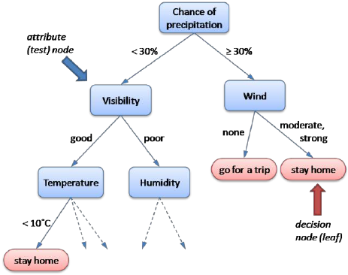
ML Model: decision trees
Easiest to comprehend
White-box algorithm
Performs decently, even when applied trivially
A supervised learning paradigm

Slide 11
Tradecraft session Coding rhythm overview (not the ml process)
Run ML Model Trivially
View the Decision Space
Explore the Data's Structure
View the Feature Space relative to the Data
Explore Feature Importance
View Features Relative to model
Add more Data

Slide 12
To the notebooks!

Slide 13
Data Analysis & Machine learning resources
All things nerdy
O’Reilly Books Online [0], free for military members!
Data Analysis
Introduction to Statistics, by Jim Frost [1] | [2]
Matplotlib [6]
Machine Learning
Deep Learning for Coders with Fastai and PyTorch: AI Applications Without a PhD, by Jeremy Howard [3] (free on O’Reilly too!)
Practical Deep Learning for Coders Course, Jeremy Howard [4]
Scikit Learn [5]
Notes:
0. https://learning.oreilly.com
1. https://www.amazon.com/dp/B08FXWH6V8/ref=dp-kindle-redirect?_encoding=UTF8&btkr=1
2. https://statisticsbyjim.com/basics/introduction-statistics-intuitive-guide/
3. https://www.amazon.com/Deep-Learning-Coders-fastai-PyTorch/dp/1492045527
4. https://course.fast.ai
5. https://scikit-learn.org/stable/
6. https://matplotlib.org

